Slide 1

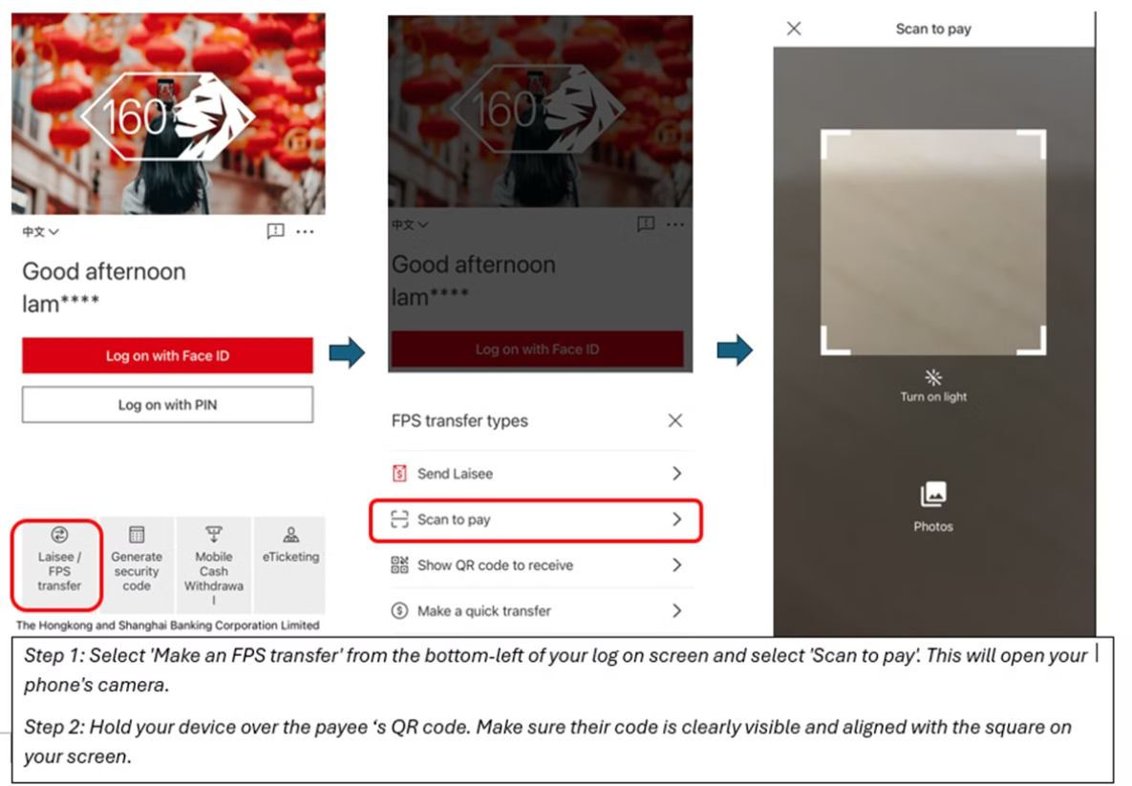
Walkthrough Sample

Slide 2
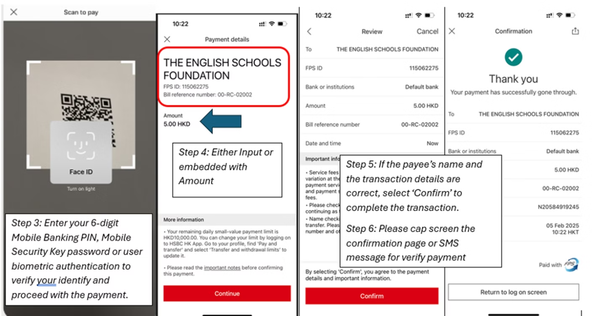
Walkthrough Sample

Slide 3
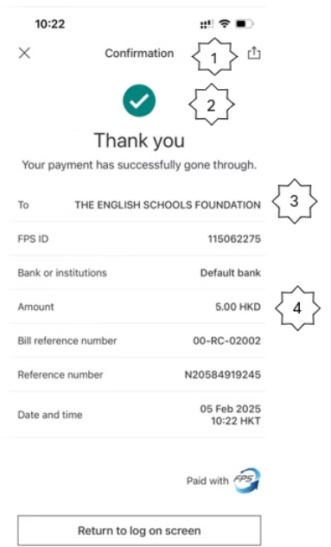
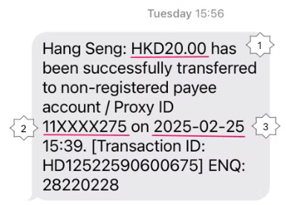
FPS Payment Confirmation
Confirmation Slip
SMS
Confirmation
Amount
Thank you
Proxy ID: 11XXXX275
To "THE ENGLISH SCHOOLS FOUNDATION"
Transaction Date
Amount

